Slide 1
MRS IMPORTING DATA
DATA INGENSTION

Slide 2
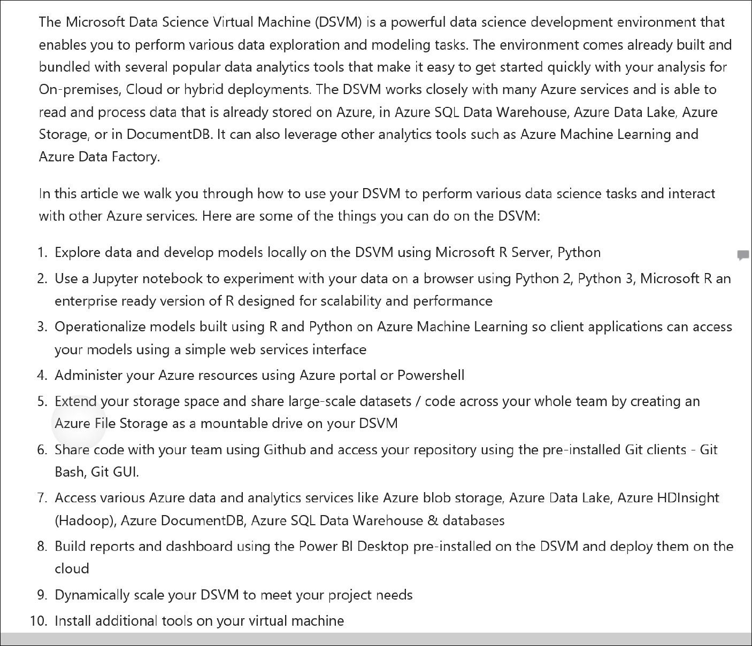
The Data Science Virtual Machine

Slide 3
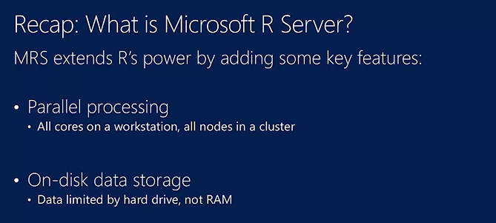

Slide 4
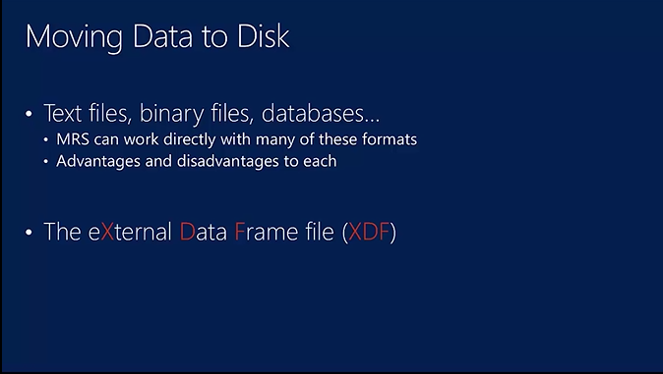

Slide 5
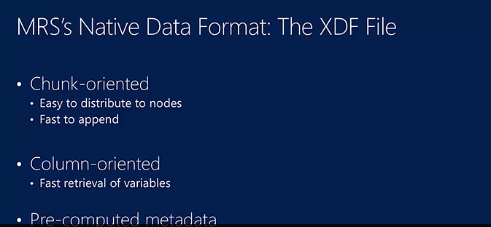

Slide 6
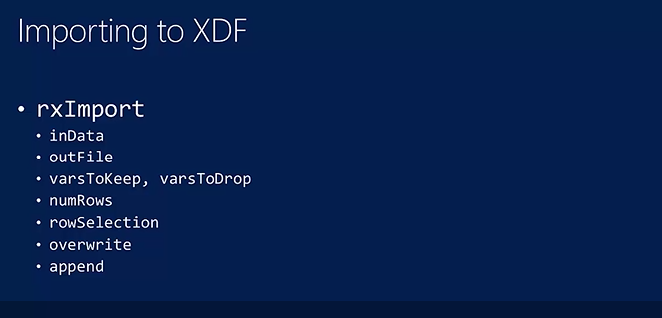

Slide 7
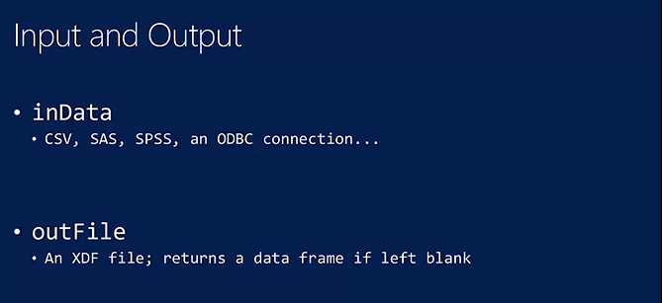

Slide 8
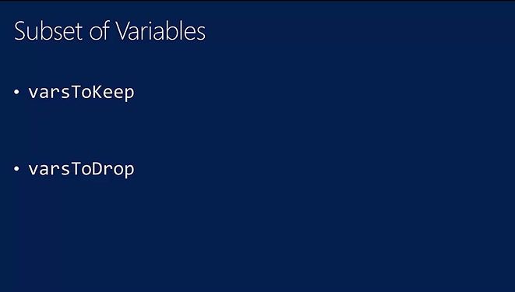

Slide 9
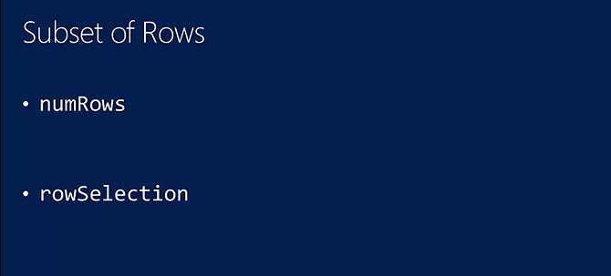

Slide 10
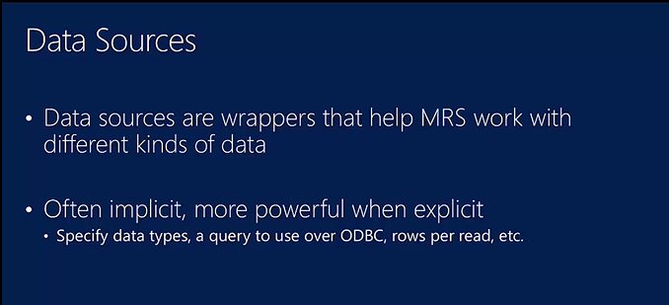

Slide 11
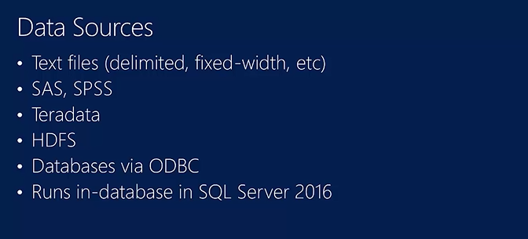

Slide 12
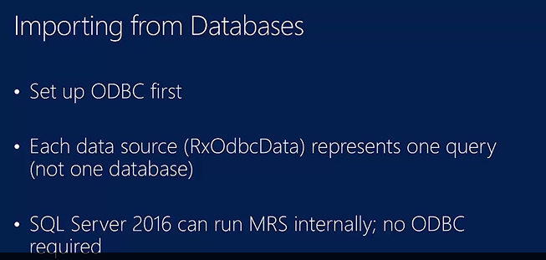

Slide 13
# Read the data into a data frame in memory /Create XDF file
# Example 1
dataDir <- "C:\\Users\\sonan\\Documents\\Revolution Demos\\SampleData"
mortXdfTrain<- file.path(dataDir,"mortDefaultSmall2008.xdf")
mortXdfTest <-file.path(dataDir,"mortDefaultSmall2009.xdf")
mortDF <- rxDataStep(mortXdfTrain)
#Example 2
bigAirDataDF<- rxXdfToDataFrame(bigAirData)
bigAirData<- file.path(dataDir,"AirlineDataSubsample.xdf")
bigAirDataDF <- rxDataStep(bigAirData,maxRowsByCols = 132118240)
#Example 3
mortXdfTrain <- file.path(rxGetOption("sampleDataDir"), "mortDefaultSmall2008.xdf")
mortXdfTest <- file.path(rxGetOption("sampleDataDir"), "mortDefaultSmall2009.xdf")
dataDir <- "C:\\Program Files\\Microsoft\\R Server\\R_SERVER\\library\\RevoScaleR\\SampleData"
#IMPORT THE DATA
rxImport(inData = "mortDefaultSmall2008.csv", outFile = "mortDefaultSmall2008.xdf",
colClasses = c(creditScore = "integer",
yearsEmploy = "integer",
ccDebt = "integer",
year = "integer",
default = "factor"),overwrite = TRUE)

Slide 14
#IMPORT THE DATA
rxImport(inData = "mortDefaultSmall2008.csv", outFile = "mortDefaultSmall2008.xdf",
colClasses = c(creditScore = "integer",
yearsEmploy = "integer",
ccDebt = "integer",
year = "integer", default = "factor"),overwrite = TRUE)

Slide 15
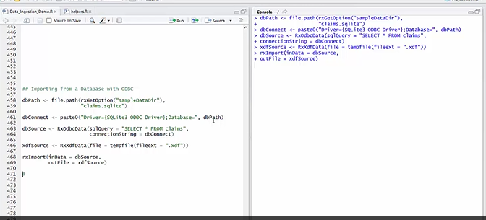

Slide 16
